Slide 1
CS35L – 5
Week 9 Lec 2

Slide 2
GIT Repository Objects
●
Objects used by GIT to implement source control
–
Blobs
●
Sequence of bytes. Correspond more or less to inodes/ file contents
–
Trees
●
Groups blobs/trees together. Correspond to UNIX directories
–
Commit
●
Refers to a particular “git commit” Contains all information about the commit
–
Tags
Just a named commit object for convenience (example: versions of the software)
Objects uniquely identified with hashes
●
●

Slide 3
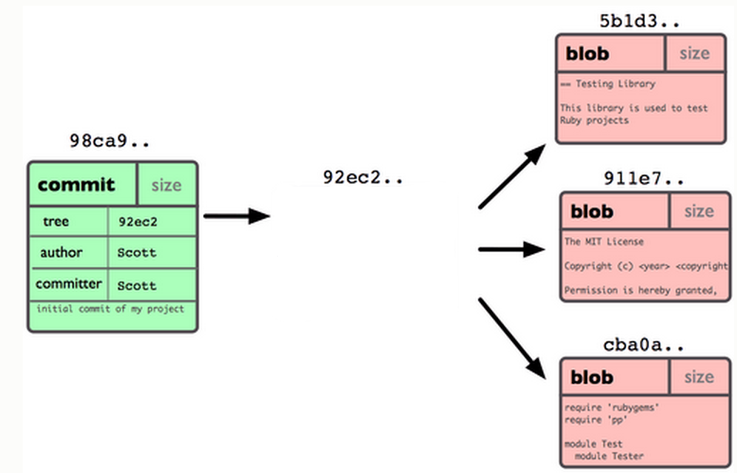
Git Repo Structure
Snapshot
tree |  | size
blob | 5b1d3 | README
blob | 911e7 | pacman.c
blob | cba0a | pacman.h

Slide 4
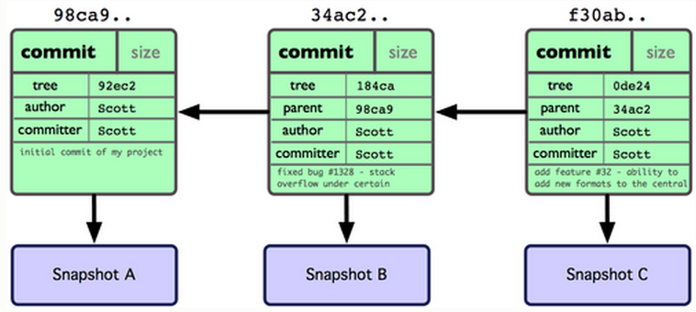
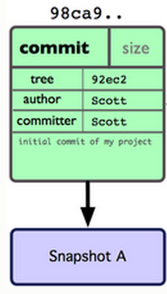
After 2 More Commits…

Slide 5
Homework 9
Publish patch you made in lab 9
Create a new branch “quote” off of version 3.0
Branch command + checkout command (git branch quote v3.0; git checkout quote)
$ git checkout v3.0 -b quote
Use patch from lab 4 to modify this branch
Patch command
$ patch –pnum < quote-3.0-patch.txt
Modify ChangeLog file in diffutils directory
Add entry for your changes similar to entries in ChangeLog
Commit changes to the new branch
$ git add . $ git commit –F <Changelog file>
Generate a patch that other people can use to get your changes
$ git format-patch -[num] --stdout > formatted-patch.txt
Test your partner’s patch
Check out version 3.0 into a tmp branch
Apply patch with git am command: $ git am < formatted-patch.txt
Build and test with $ make check
Make sure partner’s name is in HW9.txt for #8

Slide 6
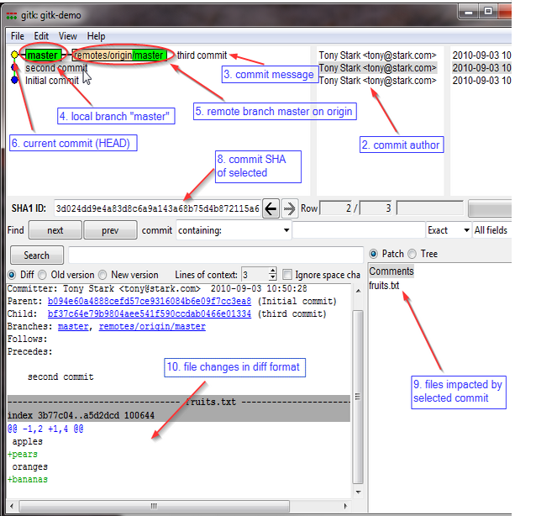
Gitk
A repository browser
Visualizes commit graphs
Used to understand the structure of the repo
Tutorial: http://lostechies.com/joshuaflanagan/2010/09/03/use-gitk-to-understand-git/

Slide 7
Gitk
SSH into the server with X11 enabled
ssh -X for OS with terminal (OS X, Linux)
Select “X11” option if using putty (Windows)
Run gitk in the ~eggert/src/gnu/emacs directory
Need to first update your PATH
$ export PATH=/usr/local/cs/bin:$PATH

